Slide 1
HURRICANE EARL

Slide 2
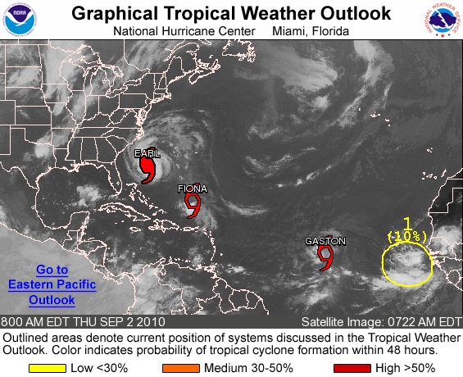

Slide 3
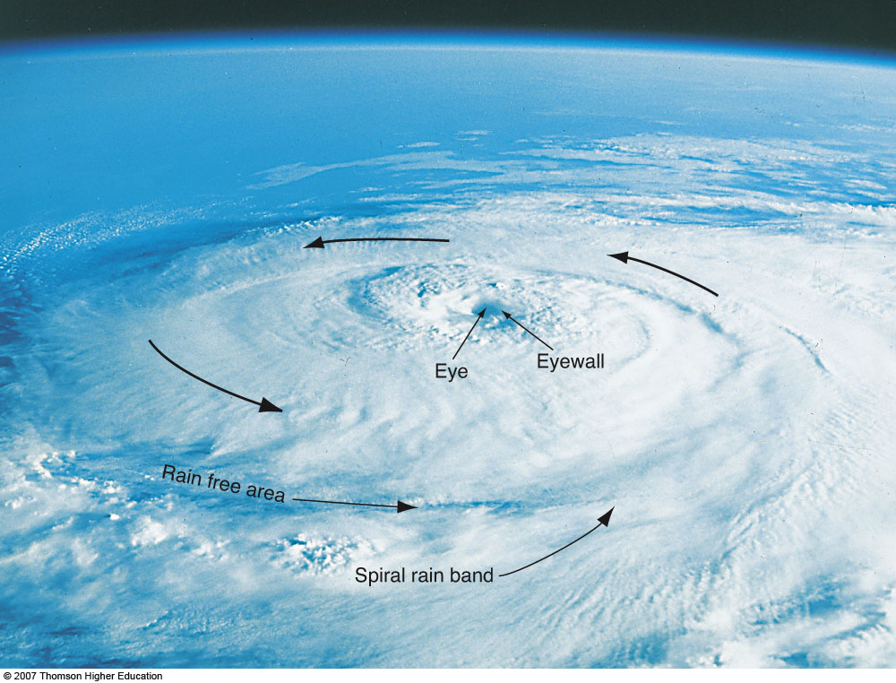

Slide 4
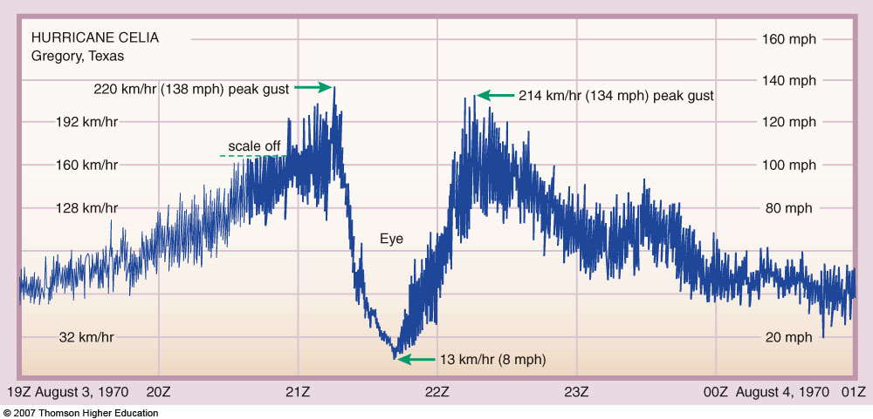
Fig. 8-24, p. 229

Slide 5
TROPICAL CYCLONE DAMAGE
WIND DAMAGE
STORM SURGE
INLAND FLOODING

Slide 6
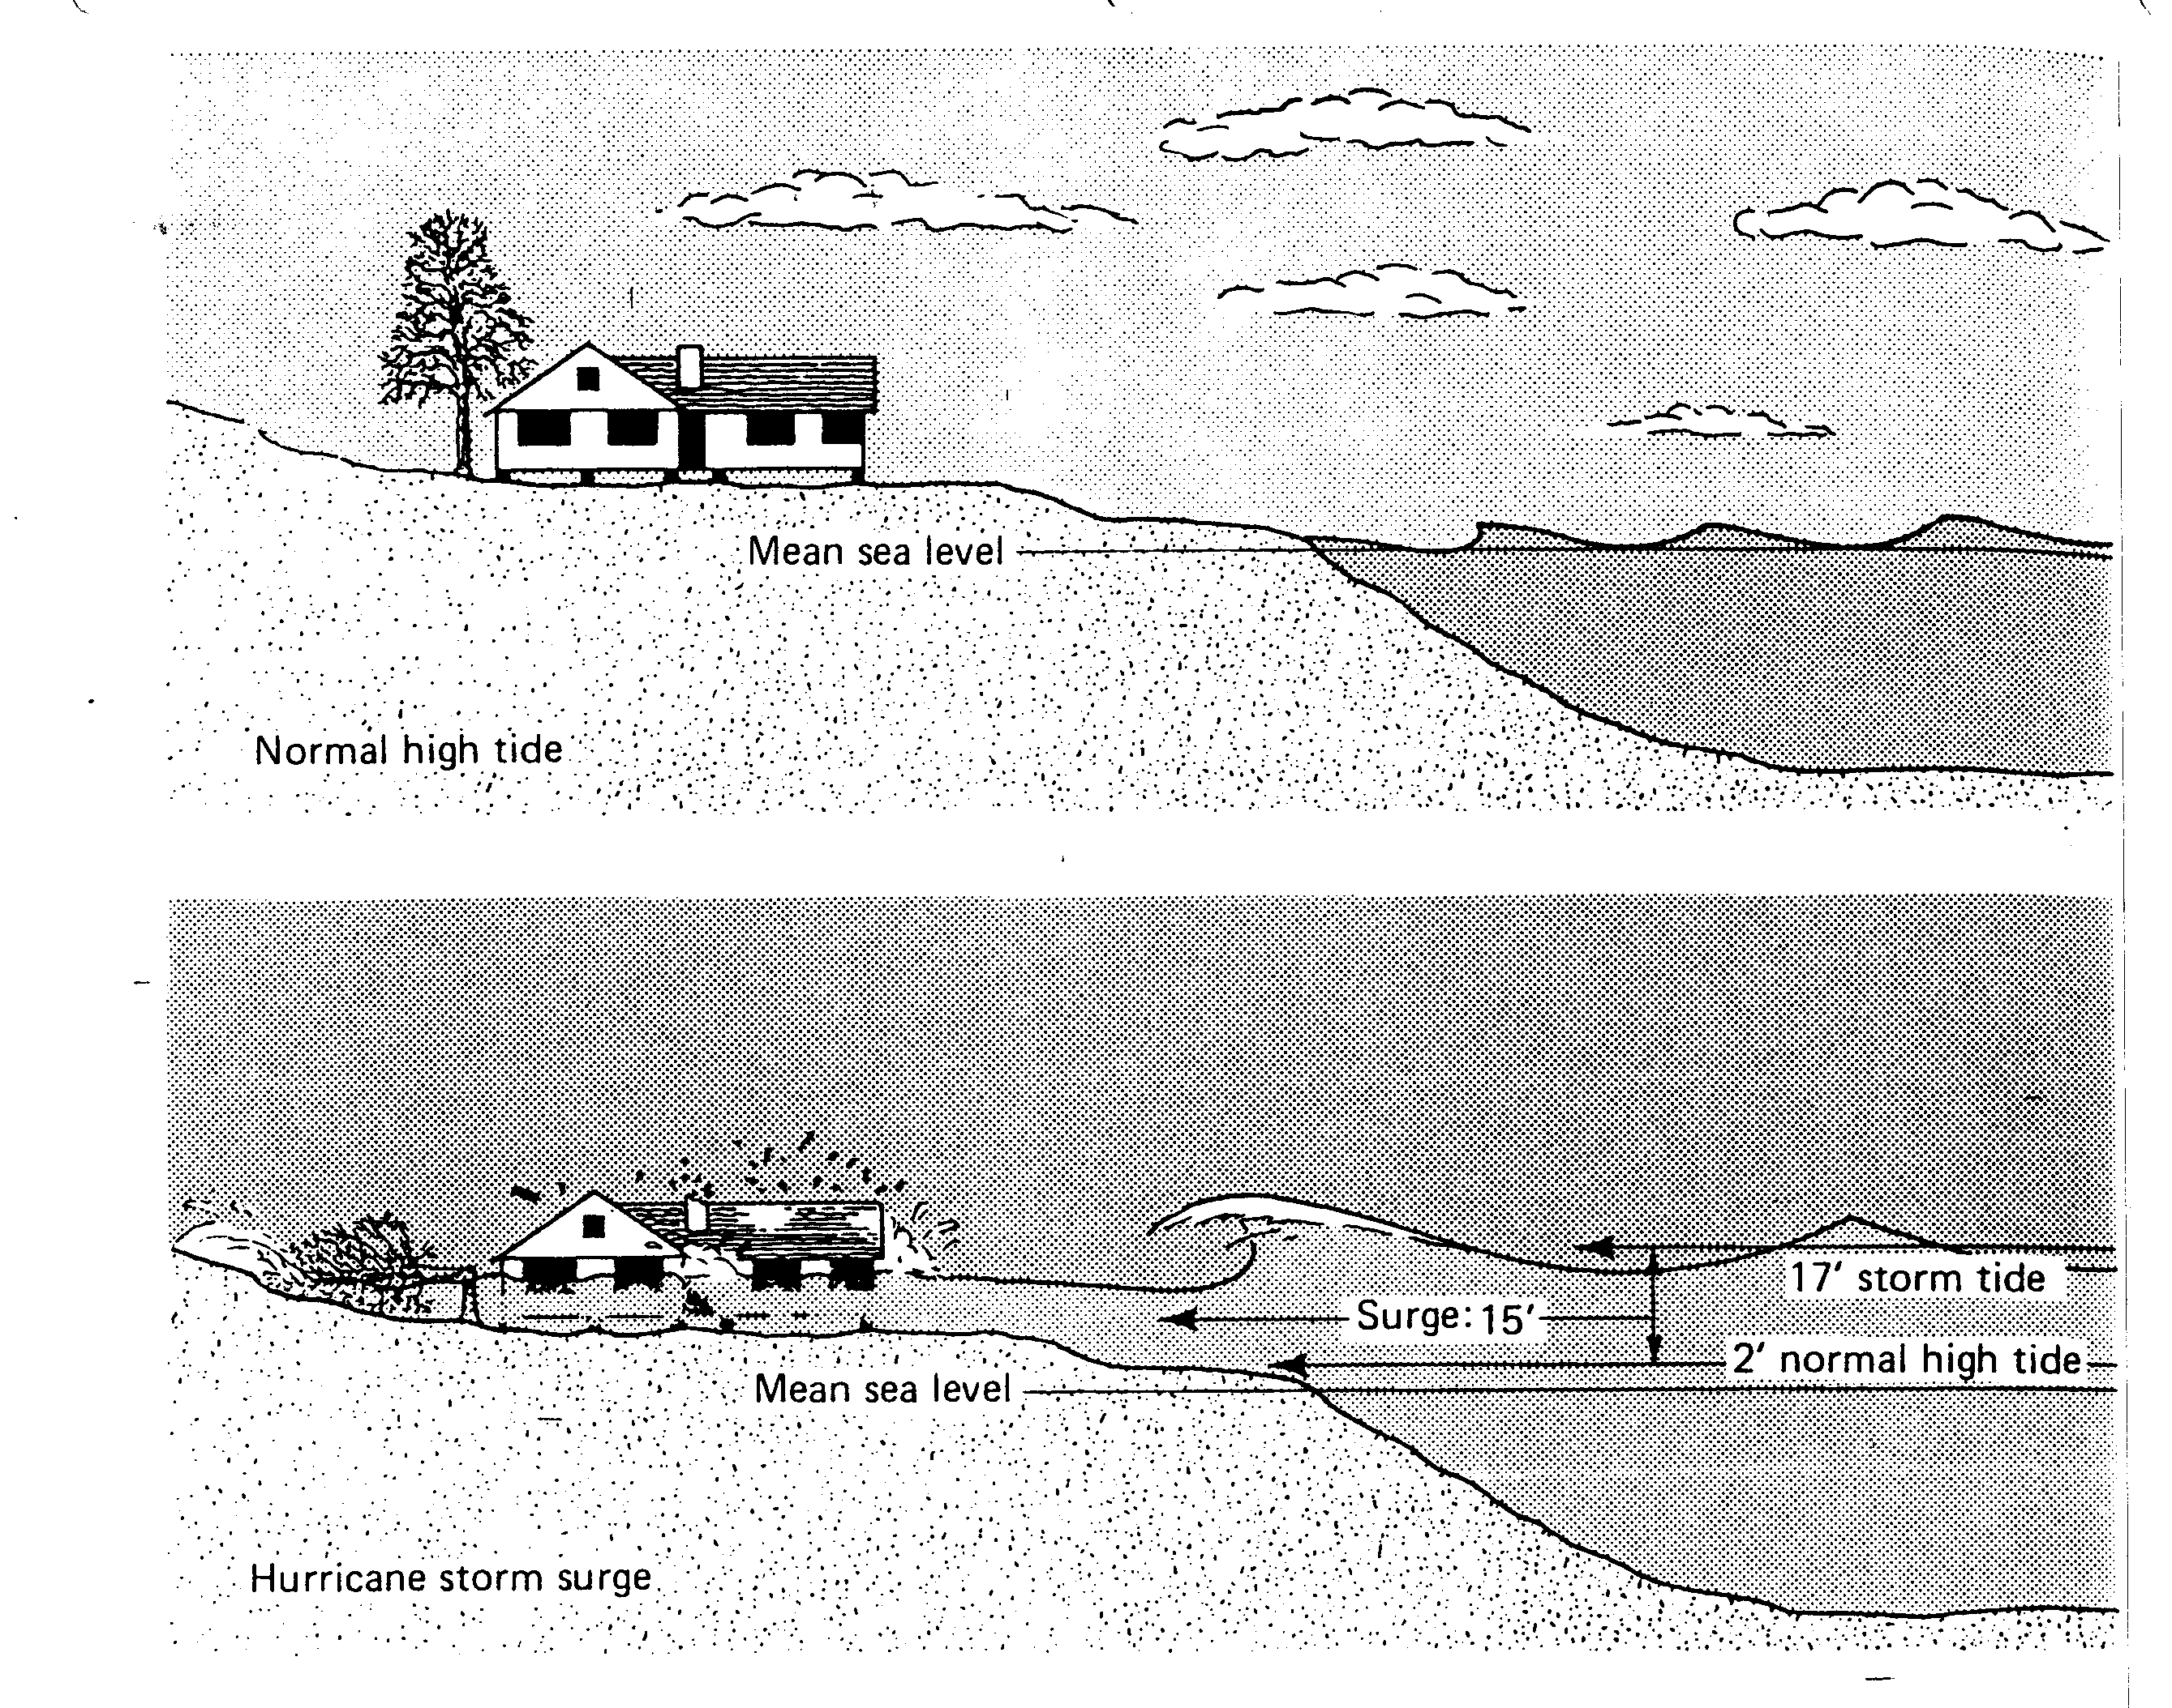
STORM SURGE

Slide 7
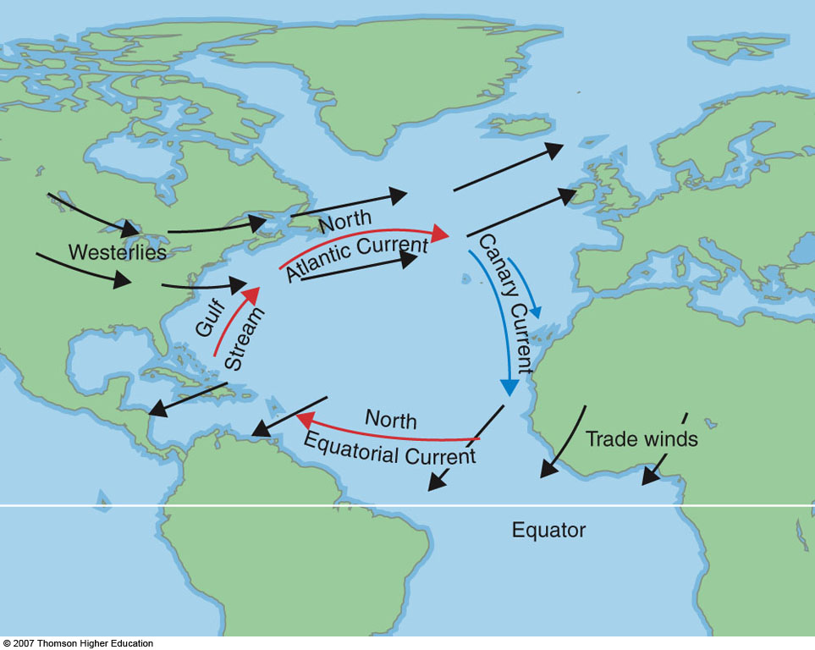
Fig. 8-8, p. 215

